Slide 1

Data analysis
boking the bikes

Slide 2
Excel Foundations & Data Handling
Shorting and filtering data
To filter and sort data in Excel, I can use keyboard shortcuts or the Data and Home tabs. To apply a filter, select the instant data and press Ctrl + Shift + L or click Filter from the Data or Home tab, then use the dropdown arrows in the headers to choose your criteria.
instant
620
621
622
623
624
625
626
627
628
instant
611
612
613
614
615
616
617
618
619
Steps:
Select the instant column.
Go to Data tab apply short and filter.
Click Short A Z buttons.

Slide 3
Use basic formulas: SUM, AVERAGE, COUNT, TEXT functions:
The sum function is used to add (sum) a range of number in excel
Formula syntax:
=SUM(number1,number2,…)
Example:
=SUM(S4,T4)
This adds all the value of s4, t4 and gives us total number of casual and registered booking day
Wise data.

Slide 4
Day | No. of casual | No. of Registered | Total
Sat | 18.0004 | 714 | 732.0004
Sun | 24.866 | 576 | 600.866
Mon | 18.4478 | 364 | 382.4478
Tue | 10.1649 | 346 | 356.1649
Wed | 20.822 | 228 | 248.822
Thu | 15.0901 | 212 | 227.0901
Fri | 15.6427 | 290 | 305.6427
Total | 123.0339 | 2730 | 2853.034
Here we can find total sales using sum and sumif formula to finding number of casul and registered data.

Slide 5
Average :
In the Excel AVERAGE formula calculates the arithmetic mean by summing a range of numbers and dividing by the count of those numbers.
To find the average of casual boking and and registered boking I can use this average formula.
Syntax:
=AVERAGE(number1, [number2], ...)
Example:
=AVERAGE(G2:G611)

Slide 6
Based on Humidity Casual and Registered Booking
Booking | higher humidity | Medium humidity | Lower humidity | Total | Count | Average
Casual | 914 | 1499 | 333 | 2746 | 610 | 4.507389163
Registered | 10173 | 18126 | 2853 | 31152 | 610 | 51.06885246
Count:
Here we can also use count function for counting the number of registered and casual booking,
Syntax:
=count(range)
Example:
=COUNT(G2:G611)

Slide 7
Text function:
It uses a format text argument to control how the number is displayed. This allows you to add currency symbols, commas, or specific date formats .
dteday
01-01-2011
Day
Sat
Sat
Syntax:
24-12-2010
25-12-2010
26-12-2010
27-12-2010
28-12-2010
29-12-2010
30-12-2010
31-12-2010
01-01-2011
02-01-2011
Sat
Sat
Sat
Sat
Sat
Sat
Sat
Sat
Sat
Sat
Sun
=text(B2,”ddd”)
Here we can find day with the help of text function we can select dteday column and use text funtion for finding week name.

Slide 8
Conditional Formatting:
Automatically apply visual formatting to data based on specific rules.
Highlighting Key Data with Conditional Formatting
Select the data:
Choose the range of cells you want to analyze.
Define the rule:
Create a condition, such as “night shift," turns into colour.
Instant insight:
The formatting is applied automatically and updates in real-time as your data
changes.

Slide 9
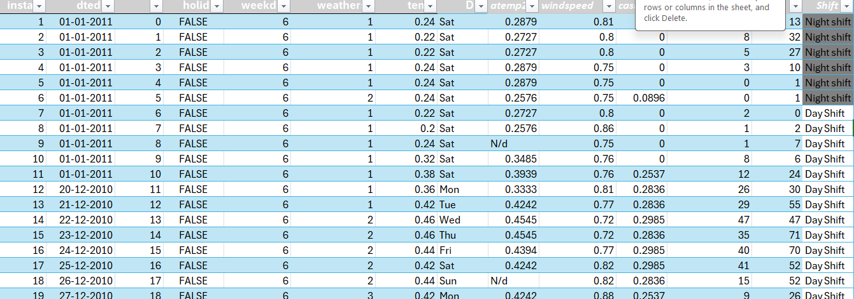

Slide 10
Merge Data sheet:
Merging Data in Excel using VLOOKUP with common instant row and adding humidity, atemp, casual, registered and cnt column understanding temperature casual, registered boking and total number of boking.
instant | dteday | hr | holiday | weekday | weathersit | temp | Day |  | hum | windspeed | casual | registered | cnt
1 | 01-01-2011 | 0 | FALSE | 6 | 1 | 0.24 | Sat |  | 0.2879 | 0.81 | 0 | 3 | 13
2 | 01-01-2011 | 1 | FALSE | 6 | 1 | 0.22 | Sat |  | 0.2727 | 0.8 | 0 | 8 | 32
3 | 01-01-2011 | 2 | FALSE | 6 | 1 | 0.22 | Sat |  | 0.2727 | 0.8 | 0 | 5 | 27
4 | 01-01-2011 | 3 | FALSE | 6 | 1 | 0.24 | Sat |  | 0.2879 | 0.75 | 0 | 3 | 10
5 | 01-01-2011 | 4 | FALSE | 6 | 1 | 0.24 | Sat |  | 0.2879 | 0.75 | 0 | 0 | 1
6 | 01-01-2011 | 5 | FALSE | 6 | 2 | 0.24 | Sat |  | 0.2576 | 0.75 | 0.0896 | 0 | 1
7 | 01-01-2011 | 6 | FALSE | 6 | 1 | 0.22 | Sat |  | 0.2727 | 0.8 | 0 | 2 | 0
Synatax:
=VLOOKUP($A2,instantc,2,FALSE)

Slide 11
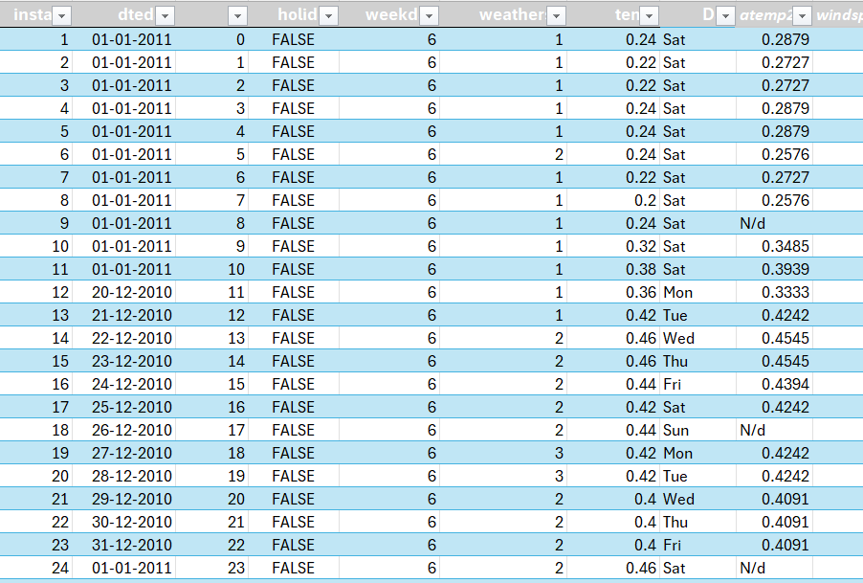
Detect and handle missing:
Using "Go To Special" in Excel is an efficient way to detect and handle missing data, or blank cells. After selecting the temperature column , we can fill them with a N/D (do data found), the value and click control enter and all the data fill with N/D.
Select your data range:-
. Click on a cell within your dataset and press Ctrl + A to select the entire table.
2. Open "Go To Specialial “:-
On the Home tab, go to the Editing group, click Find &
Select, and choose Go To Spec
3. Find the blanks:-
In the "Go To Special" dialog box, select the Blanks option and click OK.

Slide 12
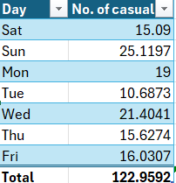
Excel will immediately highlight all truly blank cells within your selected data range.
After using "Go To Special" to select all blanks, simply type value N/D into the active cell and press ctrl + enter then all sell blank sell fill it with N/D.
Remove duplicates
To remove duplicates, select day column, go to the Data tab, and click Remove Duplicates and find unique data
Select your data:
Click day cell inside the data set or select the range of cells you want to check for duplicates.
Go to the Data tab:
Click the Data tab on the Excel ribbon.

Slide 13
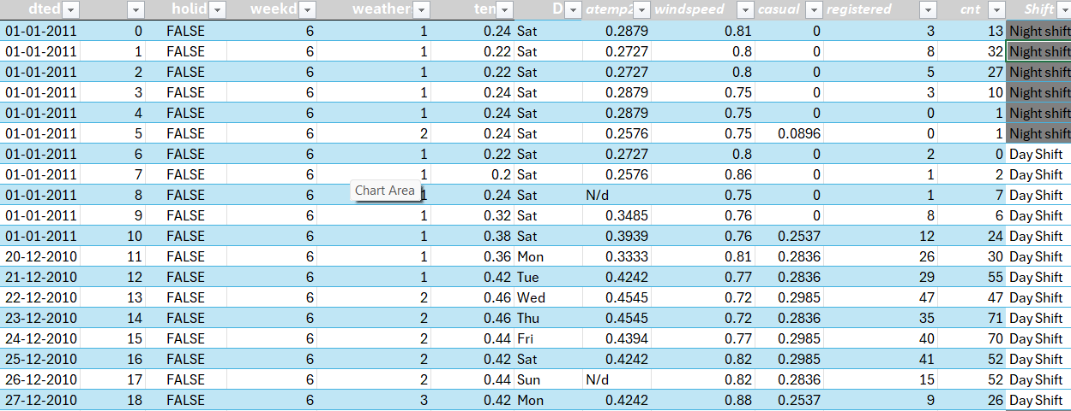
Click the Data tab on the Excel ribbon:-
In the Data Tools group, click the Remove Duplicates button. Then choose columns to check and make my data first data has headers box.
Conditional Logic & Lookup Functions
IF statements:-
Using if statement we can organize day and night shift 6hr to 18hr is day shift and 19hr to 5hr is night shift
Syntax:-
=IF(AND(C2>=6,C2<=18),"Day Shift","Night shift")

Slide 14

INDEX, MATCH statement
The INDEX and MATCH formula in Excel is a powerful tool that combines the functions of INDEX and MATCH to look up and retrieve a value from a table or range.
Here I can take instant column and total registered booking using index and match function.
Synatax:-
=INDEX($P$2:$P$391,MATCH($AB$6,$A$2:$A$391,0))

Slide 15
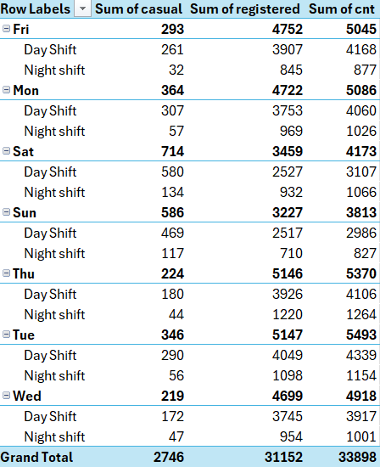
Pivot tables:-
A pivot table in Excel is an interactive tool to quickly summarize, analyze, and explore large datasets by creating a table of values that are aggregations of individual data points.
Here I found day wise and shift wise booking data of sum of casual data, sum of registered booking and total number of booking
Insert PivotTable:-
Go to the Insert tab on the ribbon and click PivotTable. Excel will automatically detect your data range. Confirm the range is correct and select where you want the PivotTable to be placed on next work sheet. Click OK.

Slide 16
Pivot chart:-
A pivot chart is a graphical representation of data from a pivot table, allowing you to interactively visualize and summarize large datasets. To create one, select any cell in your data, go to the "Insert" tab, and click "PivotChart".
in this Excel pivot chart we find sum of registered casual and total number of booking on the basis of shift.

Slide 17
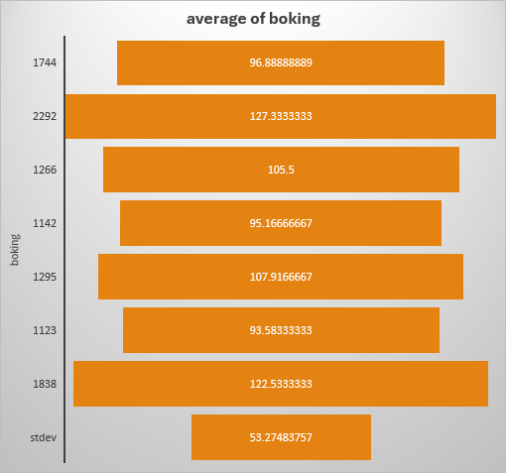
Funnel chart:
To create a funnel chart in Excel, I can select data and creating average booking sale day wise .
Steps:-
Go to the Insert tab in the Excel ribbon.
In the "Charts" group, find and click the Funnel chart icon.
Select Funnel from the dropdown menu.

Slide 18
Line chart:-
For createing a line chart in Excel, first select the data, then go to the Insert tab and click the Line or Area Chart icon in the Charts group
Here we can showing the day, night and total number of shift on the basis of days.
Step:-
Select your data
Go to the Insert tab
Choose the Line chart option
Select a line chart type
Customize your chart (optional)

Slide 19
Forecasting sheet:-
The Forecast Sheet tool automates the process, providing a new worksheet with a data table and a chart showing historical and predicted values,
Step:-
Enter the historical data into two columns first is date and second values is total booking.
Select both data series.
Go to the Data tab and click Forecast Sheet.
In the dialog box, choose a line or column chart and select the end date for forecast period using the calendar.
Click Options to adjust the confidence interval, specify seasonality, or fill in missing data points.
Click Create. Excel will generate a new worksheet with a forecast table and chart.

Slide 20
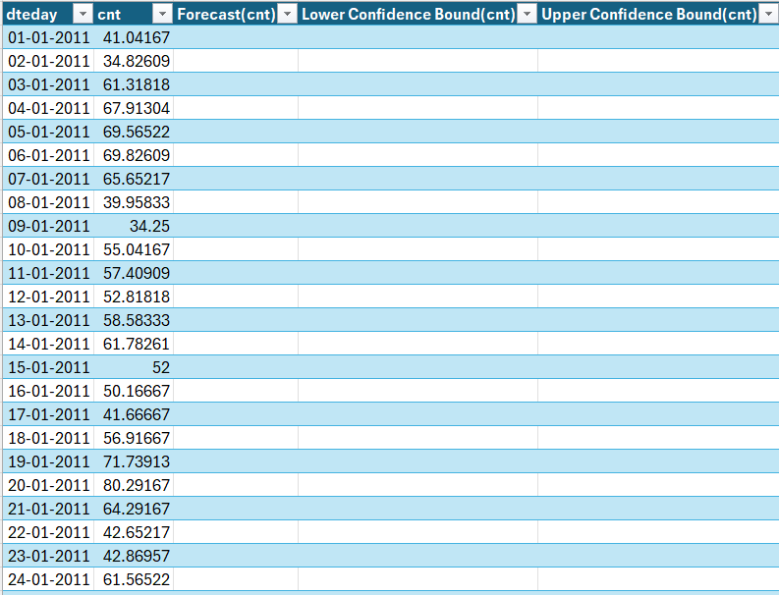

Slide 21
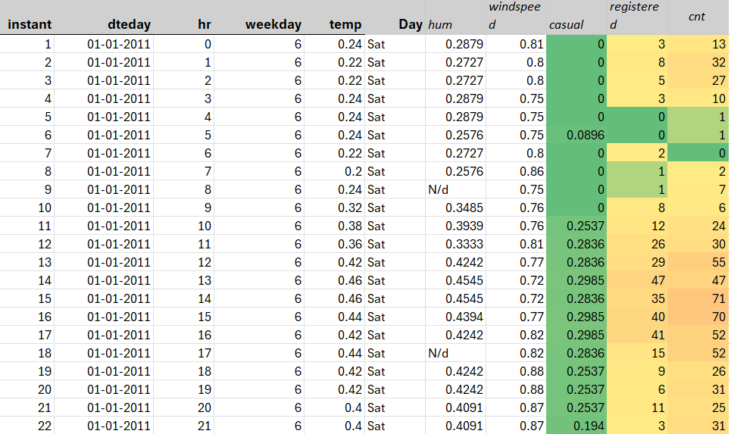
Heatmap:-
We can create a heatmap in Excel using Conditional Formatting by selecting casual registered data, going to the "Home" tab, clicking "Conditional Formatting," and then choosing a "Color Scale"
Step:-
Select your data
Open Conditional Formatting
Choose Color Scales
Customize the data in colour

Slide 22
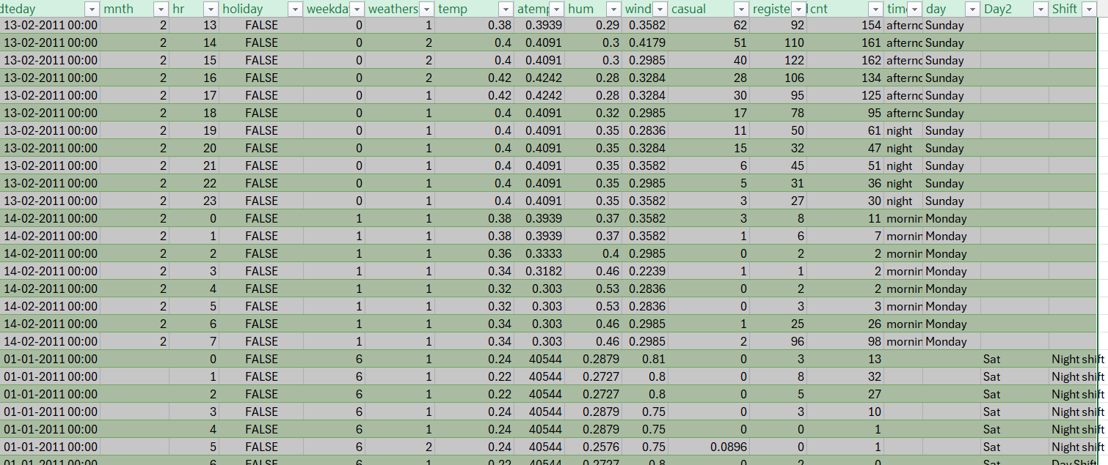
Append table:-
Combine data vertically from data sheet1 and data sheet3 files into one using Power Query, which is the most robust method for large or external datasets
We go to data and combine the quries and append the data sheet.
Here we can add both sheet data into on table
For append this data go to Data > Get Data > Combine Queries > Append and click ok
My append file is created in a new sheet.

Slide 23
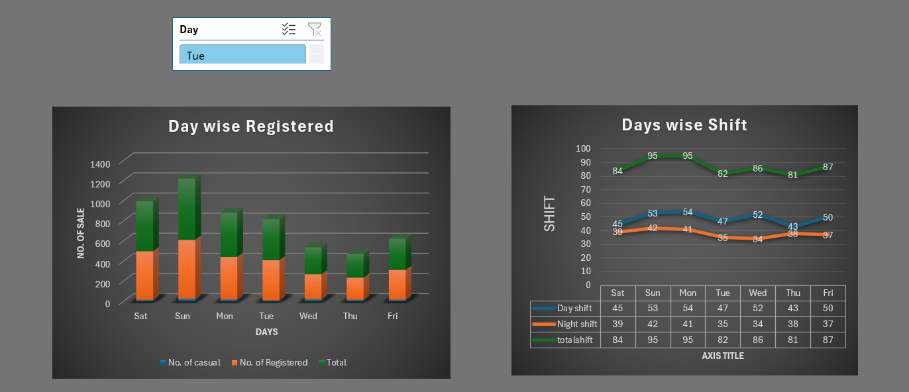
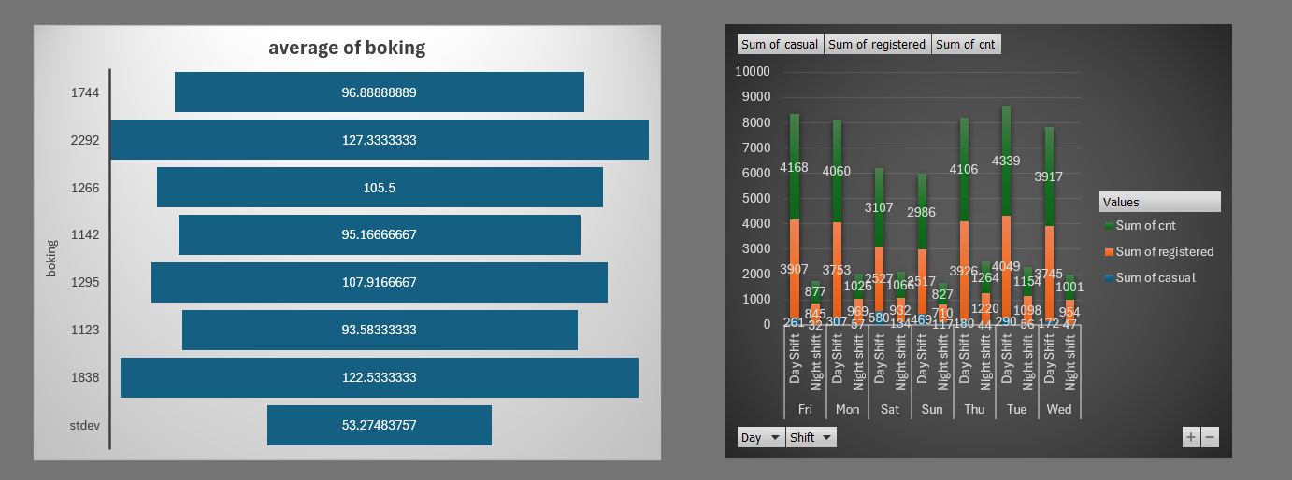
Dashboard:-
This dashboard provides a comprehensive view of day-wise booking performance,enabling easy monitering and analysis of both casual and registered booking .
Aggregates total shift for each selected period to gives a quick operational overview.
This slicer allows user to filter and analyze data for specific days of week.
Dashboard automatically updates when new booking data is added.

Slide 24
thank
you

